Slide 1
Finance and Risk Analytics
Presented By :
Rani Mondal
Monil Gothwal
Lohith Raj
Santosh Gouda

Slide 2
Agenda
Objective
Methodology
Insights And Visualization
Portfolio Analysis

Slide 3
Objective
Research investment funds based on client needs and provide investment management recommendations. My job is to consult two different entrepreneurs, Mr. Patrick jyenger and Mr. Peter jyenger according to their needs and financial goals.
Mr. Patrick jyenger wants to invest $500,000 in stocks, he has been A conservative investor his entire life and expects to double his investment in 5 years with minimal risk.
Mr. Peter jyenger wants to invest $1 million in stocks, he has been A high risk investor all his life and like high return investments and expects to double his money in 5 years with high risk.

Slide 4
Methodology
Exploratory data analysis
Check for null values ​​in the record and also check that no fields with null values ​​are defined.
Check the dataset file for outliers
Fb's estimated value is "0" due to its listing on the New York stock exchange on may 18, 2012.
Data analysis
Analyze stock data using a variety of calculations, include daily return, cumulative daily returns, Sharpe ratio, investment risk and return on investment(roi).
Find the best stocks for each individual investors.
Perform analysis to better understand every industry.
Use power bi for better visibility and understanding.
Performed sector-wise analysis to get a better view of each sector.

Slide 5
Methodology
Evaluation after analyzing the data
Over the past 5 years, 7 stocks have yielded over 80%.
The most profitable stocks were AMZN, MSFT, AAPL, FB, UNH, GOOG, and MS.
Each stock’s risks and returns are influenced by its annual risk, Sharpe ration and cumulative return.
Amzn offers the highest returns among all stocks, but it also carries higher risk compared to other stocks.
The study revealed that stocks like JNJ, RHHBY, MRK, MSFT offer higher returns and lower risk.
The technology sector is the most successful, followed by the financial sector, while the aviation industry is the worst, followed by healthcare and medicine.
After conducting thorough analysis, we have decided to finalize a product mix for two distinct customers.

Slide 6
Insights And Visualization
Ticker | Industry | Company Name
AAL | Aviation | American Airlines Group Inc.
ALGT | Aviation | Allegiant Travel Company
ALK | Aviation | Alaska Air Group Inc.
DAL | Aviation | Delta Air Lines Inc.
HA | Aviation | Hawaiian Holdings Inc.
LUV | Aviation | Southwest Airlines Co.
BCS | Finance | Barclays
CS | Finance | Credit Suisse
DB | Finance | Deutsche Bank
GS | Finance | Goldman Sachs
MS | Finance | Morgan Stanley
WFC | Finance | Wells Fargo
JNJ | Pharmaceuticals | Johnson & Johnson
MRK | Pharmaceuticals | Merck and CO Inc.
PFE | Pharmaceuticals | Pfizer Inc.
UNH | Pharmaceuticals | United Health Group Inc.
BHC | Pharmaceuticals | Bausch Health Companies Inc.
RHHBY | Pharmaceuticals | Roche Holding AG
AAPL | Technology | Apple Inc.
AMZN | Technology | Amazon
FB | Technology | Facebook
GOOG | Technology | Alphabet
IBM | Technology | IBM
MSFT | Technology | Microsoft
Stocks data available
There are a total of 24 stocks in four sector, 6 stocks in each sector.
There is a metric that can be used to compare the results of stocks. S&P500 is A stock index that includes the 500 largest stocks in the US economy.
This is a list of stocks with abbreviations, sectors and company names.

Slide 7
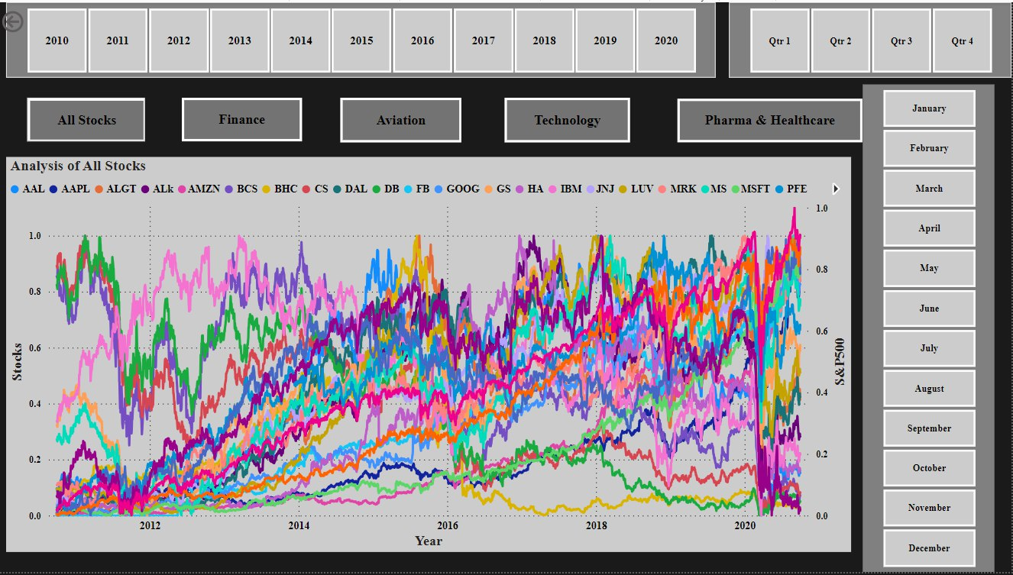
Visualization Of Stocks After Normalizing The Values
The graph above shows the performance of each stock along with the S&P500 index.
Here we compare the 10 year price of each stock.
While checking the stock, we found that Facebook stock entered the market on may 18, 2012.
We have also added buttons to the dashboard to enable specific analysis.

Slide 8
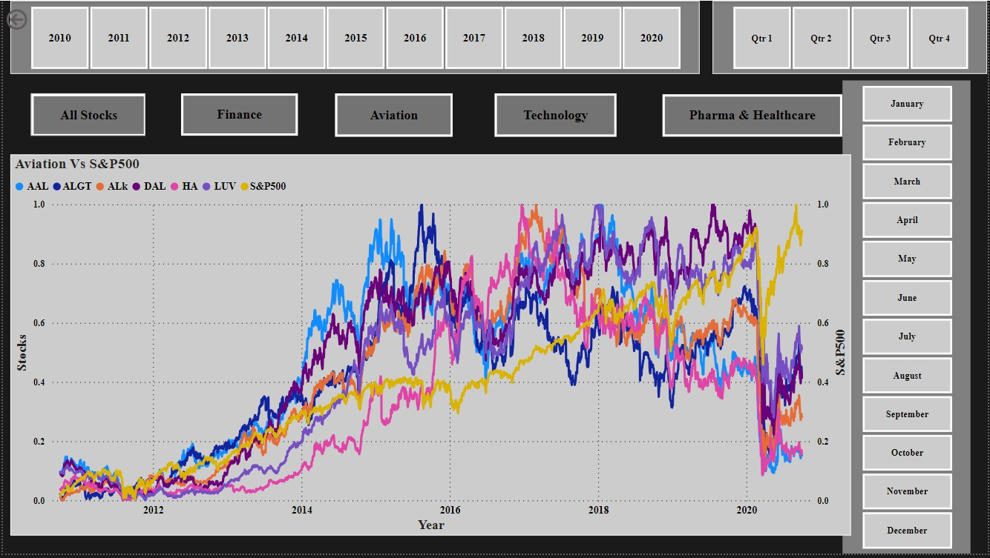
Industry Wise Analysis
Aviation Sector
The S&P500 has no relationship to the airline industry.
The market was affected by the coronavirus in 2020, causing a bear market.
Despite the economic recovery, the aviation sector performed below the market.
We see that allegiant travel company has some relationship with delta air lines.
We can also see that there are some relationship between delta air lines and southwest airlines.

Slide 9
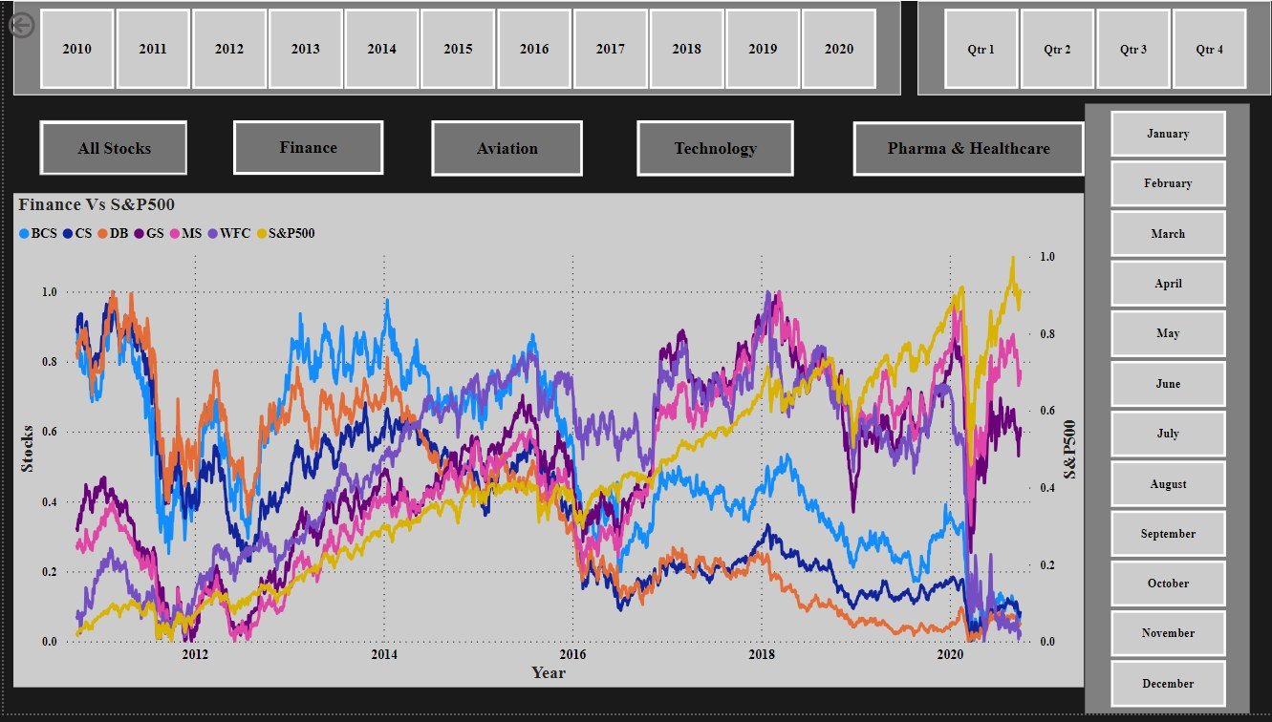
Industry Wise Analysis
Finance sector
The S&P500 index has a strong correlation with the stock market.
Although the market has been greatly impacted by the coronavirus in 2020, Morgan Stanley and Goldman Sachs may bounce back and outperform, but most stocks are still doing better after the hit.
We can also see that Goldman Sachs and Morgan Stanley have a very good relationship compared to other stocks.

Slide 10
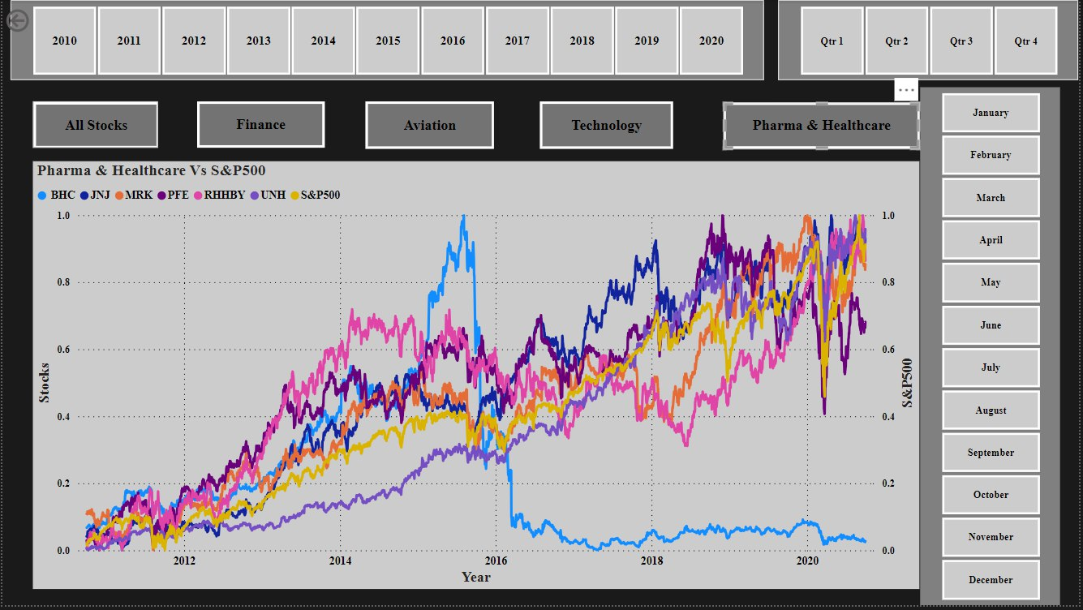
Industry Wise Analysis
Pharmaceuticals sector
The S&P500 is highly correlated with the healthcare and pharmaceutical industries (JNJ, MRK, UNH).
During the pandemic, healthcare, medicine, and technology experienced rapid growth compared to other sectors following the economic collapse.
We see the bausch health companies inc. Has not been able to grow in the last 5 years.
Overall, the healthcare and pharmaceutical sector performed well compared to the S&P500.

Slide 11
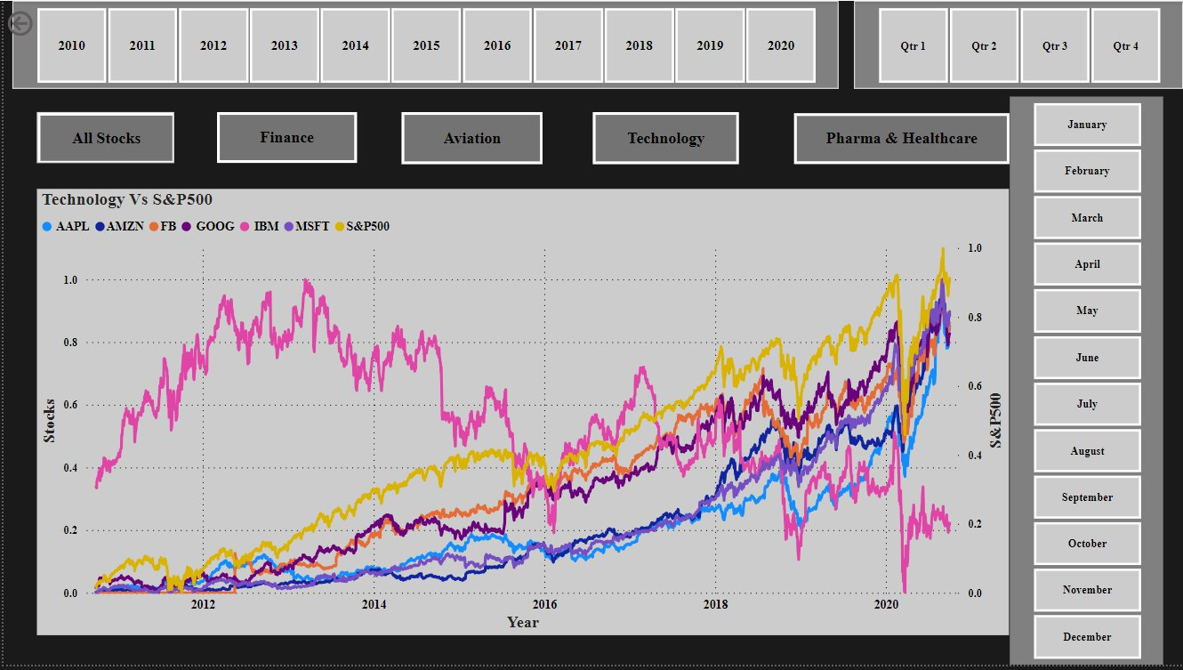
Industry Wise Analysis
Technology sector
The s&p500 is highly correlated with technology (AMZN, FB, MSFT, GOOG, AAPL).
The technology sector is one of the few sectors that recovered compared to other sectors during the pandemic.
All brands except IBM achieved commercial success.
Also, all stocks except IBM are compatible.

Slide 12
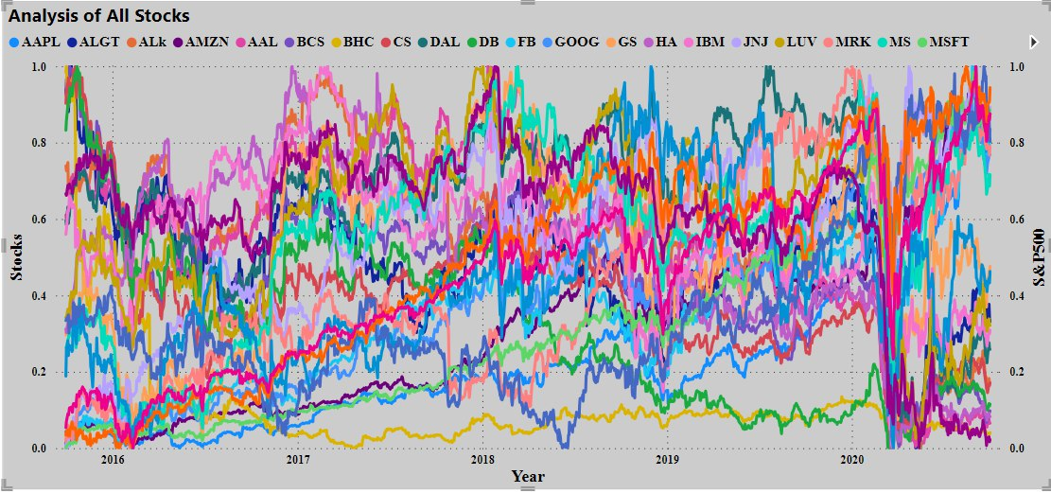
Visualization Of Stocks (Past 5 Years)
Since we needed to analyze the stock data of the last 5 years, we also created a dashboard with stock data of the last 5 years.

Slide 13
We can see the top 7 stocks that provide higher returns than the S&P500 at the end of 5 years
Scrips | Mean Daily Returns | Risk | Min Daily Returns | Max Daily Returns | Cumulative Returns | Annualized Returns | Annualized Risk | Sharpe Ratio
AMZN | 0.16 | 1.9 | -7.92 | 13.22 | 504.69 | 40.59 | 30.11 | 1.323
MSFT | 0.14 | 1.75 | -14.74 | 14.22 | 371.49 | 34.95 | 27.84 | 1.228
AAPL | 0.13 | 1.87 | -12.86 | 11.98 | 322.74 | 33.32 | 29.73 | 1.095
FB | 0.1 | 2.04 | -18.96 | 15.52 | 187.96 | 26.45 | 32.31 | 0.795
UNH | 0.09 | 1.78 | -17.28 | 12.8 | 167.36 | 23.72 | 28.27 | 0.812
GOOG | 0.08 | 1.65 | -11.1 | 10.45 | 140.41 | 21.02 | 26.23 | 0.773
S&P500 | 0.05 | 1.21 | -11.98 | 9.38 | 74.81 | 13.04 | 19.18 | 0.641
MRK | 0.05 | 1.41 | -8.9 | 10.41 | 68.02 | 12.88 | 22.33 | 0.543
JNJ | 0.05 | 1.25 | -10.04 | 8 | 59.79 | 11.35 | 19.78 | 0.536
MS | 0.06 | 2.18 | -15.6 | 19.77 | 53.49 | 14.55 | 34.62 | 0.399
RHHBY | 0.03 | 1.35 | -8.96 | 13.01 | 28.87 | 7.38 | 21.45 | 0.309
PFE | 0.02 | 1.38 | -7.73 | 8.96 | 15.26 | 5.25 | 21.95 | 0.205
GS | 0.03 | 1.99 | -12.71 | 17.58 | 14.17 | 7.64 | 31.59 | 0.218
LUV | 0.02 | 2.29 | -15.11 | 14.44 | -2.37 | 6.16 | 36.37 | 0.149
IBM | 0 | 1.61 | -12.85 | 11.3 | -15.27 | -0.04 | 25.54 | -0.031
DAL | 0 | 2.65 | -25.99 | 21.02 | -32.66 | 1.05 | 42.03 | 0.007
ALGT | 0 | 2.91 | -28.33 | 29.24 | -45.04 | -1.19 | 46.2 | -0.042
HA | 0 | 3.31 | -26.5 | 24.58 | -47.88 | 0.86 | 52.6 | 0.002
WFC | -0.04 | 2.03 | -15.87 | 14.53 | -54.3 | -10.44 | 32.3 | -0.346
ALK | -0.03 | 2.69 | -23.24 | 20.31 | -54.34 | -6.44 | 42.71 | -0.168
CS | -0.04 | 2.28 | -18.26 | 16.34 | -58.61 | -11.01 | 36.26 | -0.324
BCS | -0.05 | 2.51 | -21.85 | 15.1 | -66.62 | -13.82 | 39.87 | -0.365
DB | -0.05 | 2.77 | -17.49 | 14.02 | -68.33 | -13.33 | 44.04 | -0.32
AAL | -0.03 | 3.47 | -25.22 | 41.1 | -68.65 | -8.47 | 55.12 | -0.167
BHC | -0.09 | 4.46 | -51.46 | 33.74 | -91.35 | -22.6 | 70.72 | -0.33
AMZN's annual return is 40.59%.
MSFT's annual return is 34.95%.
AAPL's annual return is 33.32%.
FB's annual return is 26.45%.
UNH's annual return is 23.72%.
GOOG offers 21.02% annual return.
MS offers 14.55% annual return.
S&P500 returns 13.04% annually.

Slide 14
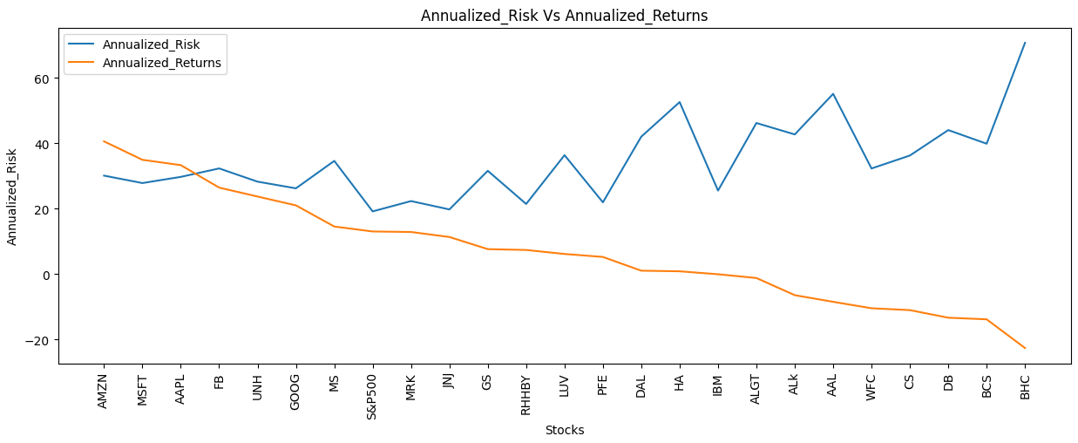
Annualized Return & Annualized Risk
The top 5 stocks with the highest annual returns are AMZN, MSFT, AAPL, FB and UNH.
The annual return of the top 5 stocks is over 20%. These five stocks are low risk stocks compared to other stocks.
With the downside comes the risk of losing money and making your first investment.
BHC, BCS, DB, CS and WFC are riskier because they do not provide return on investment even during the investment period.
JNJ, RHHBY and MRK products offer high returns with low risk.

Slide 15
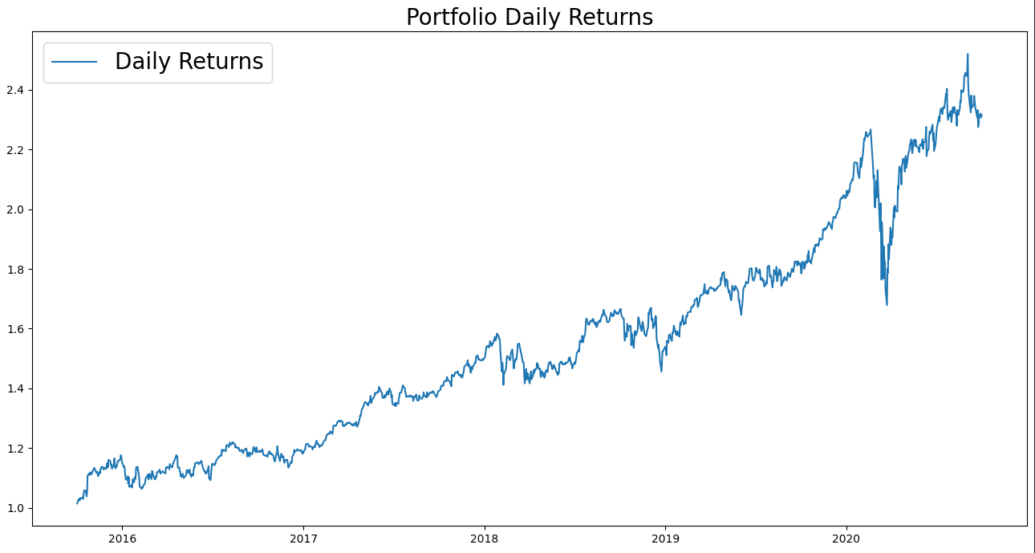
Portfolio Analysis
Mr. Patrick jyengar portfolio
Mr. Patrick jyengar aims to triple investment in the next five years. Looks for low – risk investments that can provide good returns.
Based on their profile, low risk stocks like JNJ, RHHBY and GOOG are good buys. But returns on those three stocks will lag behind for Mr. Patrick’s investment goal.
Therefore, he can invest some of his money in MSFT to get the results he wants. Weigh all items evenly so that their total weight is 0.25.
Like Mr. Patrick jyengar invests $500,000 in stock. After 5 years his return will be $1.15 million and he will have earned more than $600,000

Slide 16
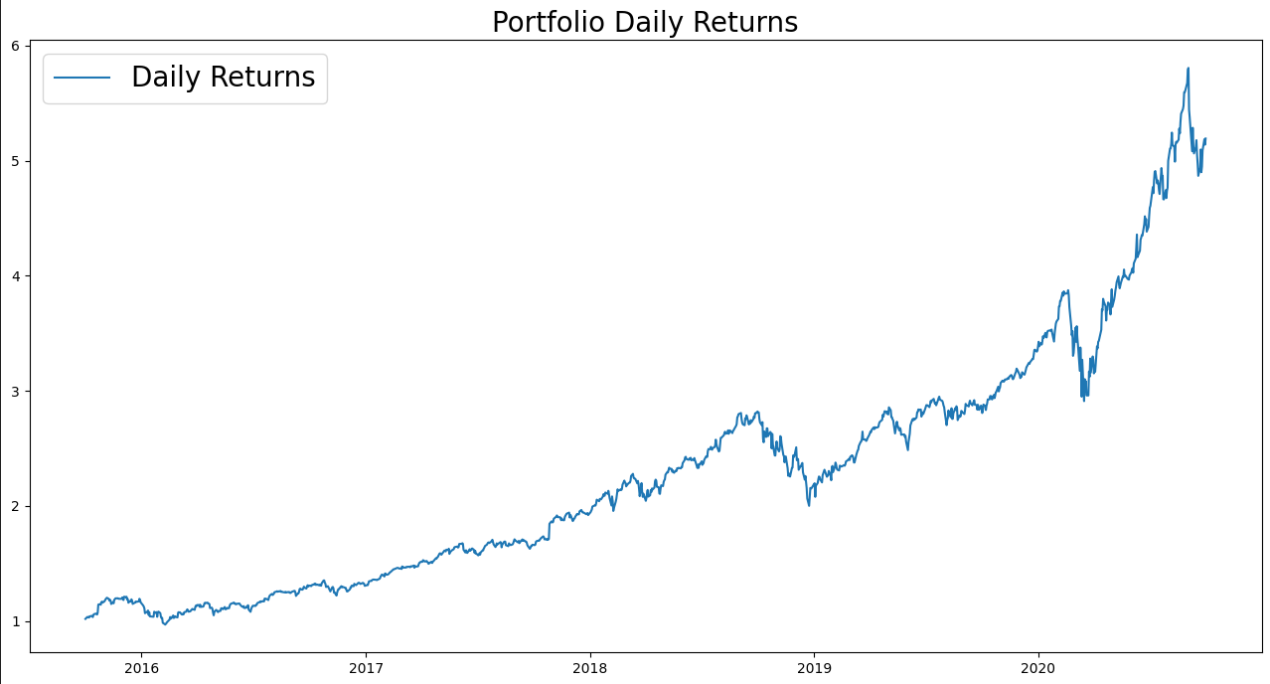
Portfolio Analysis
Mr. Peter jyengar portfolio
Mr. Peter jyengar, on the other hand, follows the risk approach and prefers investments with high returns. Even though losses occur from time to time, I believe that they can be compensated.
Wants to invest $1 million of the company’s cash and cash equivalents in the highest yielding stock expected to be profitable within 5 years for inorganic growth.
According to its profile, high risk/ high rewards are suitable investments.
The total return of this stocks will make it the highest return, but there is also risk.
Mr. Peter jyengar invested $1 million in stock. After 5 years, it will have a return of over $5 million dollars and a profit of over 4 million dollars.

Slide 17
Thank You

